Slide 1
CLASSIFICATION USING COMBINATION OF BACK-PROPAGATION NEURAL NETWORK AND MULTI-OBJECTIVE GENETIC ALGORITHM
BY MD WASIM REZA ALI
ME201310007
Under the guidance of
Mr. Dipankar Dutta
Associate Professor,
Computer Science and Engineering Department,
University Institute of Technology,
Burdwan University

Slide 2
CLASSIFICATION
Classification is the process of learning a model that describes different classes of data. The classes are predetermined.
The first step, of learning the model, is accomplished by using a training set of data that has already been classified. Each record in the training data contains an attribute, called the class label, that indicates which class the record belongs to.

Slide 3
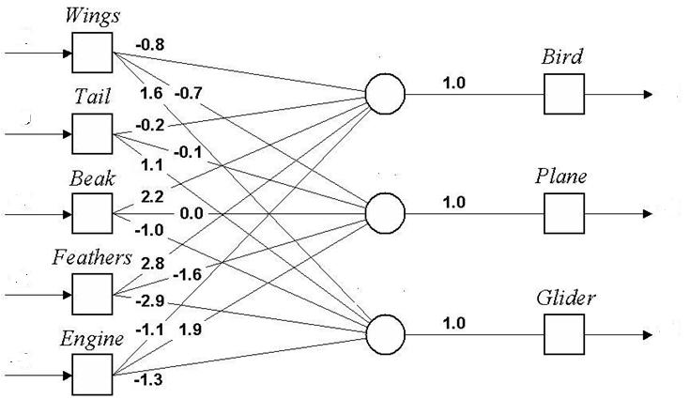
HOW TO CLASSIFY ?

Slide 4

HYBRID APPROACH
Artificial Neural Network
Genetic Algorithm
The main aim of the concept of hybridization is to overcome the weakness in one technique while applying it and bringing out the strength of the other technique to find solution by combining them.

Slide 5
WHY ARTIFICIAL NEURAL NETWORK?
Ability To Learn
Local Search
WHY GENETIC ALGORITHM?
Weight Optimisation
Topology Selection
Global Search

Slide 6
PROPOSED APPROACH
START
Build Initial population
Gen < Num of Gen
NO
Remove unnecessary weights
YES
Calculate accuracy
Crossover
Unique population
Mutation
Combine population
Pareto selection
Testing
Back propagation neural network
Gen=Gen+1
STOP

Slide 7
REMOVING UNNECESSARY WEIGHTS
START
Reduce neural network complexity
Reduce number of inter connection
Reduce number of calculation
Gene < n
Gene value < 0.01
Gene= Gene + 1
NO
YES
Gene value = 0.00
STOP

Slide 8
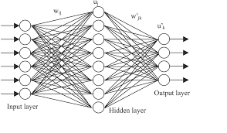
PARETO VOTING
Class label | Votes
1 | 3
2 | 1
3 | 0
4 | 0
OUTPUT
CLASS LABEL 1

Slide 9
RESULTS
Testing Result EPUNN,EANN (KEEL OUTPUT) Compared with MOGA-ANN
DATASET | MOGA-ANN |  | EPUNN |  | EANN
 | Training accuracy | Pareto voting accuracy | Training accuracy | Testing accuracy | Training accuracy | Testing accuracy
Iris | 99.3(±1.4) | 97.1(±0.7) | 98.7(±0.11) | 94.8(±0.8) | 96.2(±0.4) | 90.3(±2.1)
Heart | 64.2(±0.1) | 57.9(±1.35) | 66.2(±0.3) | 59.5(±1.3) | 68.1(±0.7) | 53.5(±1.8)
Wine | 99.9(±0.1) | 92.8(±1.9) | 100(±0) | 97.5(±1.1) | 99.9(±0.06) | 94.4(±2.0)
Breast | 98.1(±0.04) | 96.8(±0.3) | 98.4(±0.06) | 96.6(±0.4) | 98.2(±0.06) | 95.7(±0.4)
Diabetes | 78.9(±0.4) | 74.7(±1.1) | 79.3(±0.1) | 76.3(±0.6) | 80.0(±0.3) | 73.5(±1.7)
Number of zeros in MOGA-ANN
DATASET | IRIS | HEART | WINE | BREAST | DIABETES
Number of zeros | 15.7(±1.76) | 12.1(±1.2) | 19.2(±1.47) | 7.6(±1.17) | 15.4(±6.6)

Slide 10
TESTING RESULT

Slide 11
Conclusion
We have compared the output of EANN,PUNN (keel output) with our MOGA-ANN algorithm and found that our algorithm produced comparable output, Our pareto voting testing method output is comparable to other two algorithms. Further advancement can be done in this field, using of missing datasets, alphabetic ,binary dataset classification can be applied to this algorithm.

Slide 12
References
F.J. Martínez-Estudillo, C. Hervás-Martínez, P.A. Gutiérrez, A.C. Martínez-Estudillo. Evolutionary Product-Unit Neural Networks Classifiers. Neurocomputing 72:1-3 (2008) 548-561.
X. Yao. Evolving Artificial Neural Networks. Proceedings of the IEEE 87:9 (1999) 1423-1447.
J. Grefenstette, GENESIS, Navy Center for Applied Research in Artificial Intelligence, Navy research Lab., Wash. D.C. 20375-5000.
Genetic Algorithms in Optimization, Search and Machine Learning, David Goldberg, Addison Wesley, 1989.
[doi 10.1109%2FWGEC.2008.23] Chen, Ming; Yao, Zhengwei -- [IEEE 2008 Second International Conference on Genetic and Evolutionary Computing (WGEC) - Jinzhou, China (2008.09.25-2008.09.26
Artificial Intelligence in Medicine Volume 25 issue 3 2002 [doi 10.1016%2Fs0933-3657%2802%2900028-3] Hussein A. Abbass -- An evolutionary artificial neural networks approach for breast cancer diagnosis
[doi 10.1109%2Ficnn.1997.614441] Ishibuchi, H.; Nii, M.; Murata, T. -- [IEEE International Conference on Neural Networks (ICNN'97) - Houston, TX, USA (9-12 June 1997)] Proceedings of International C
Principal of soft computing (second edition) – S.N Sivanandam , S.N Deeepa
Geisser, Seymour (1993). Predictive Inference. New York, NY: Chapman and Hall. ISBN 0-412-03471-9.
Kohavi, Ron (1995). "A study of cross-validation and bootstrap for accuracy estimation and model selection". Proceedings of the Fourteenth International Joint Conference on Artificial Intelligence (San Mateo, CA: Morgan Kaufmann) 2 (12): 1137–1143. CiteSeerX: 10.1.1.48.529.
Devijver, Pierre A.; Kittler, Josef (1982). Pattern Recognition: A Statistical Approach. London, GB: Prentice-Hall.
Mosteller, Frederick (1948). "A k-sample slippage test for an extreme population". Annals of Mathematical Statistics 19 (1): 58–65. doi:10.1214/aoms/1177730290. JSTOR 2236056. MR 0024116.
Grossman,, Robert; Seni, Giovanni; Elder, John; Agarwal, Nitin; Liu, Huan (2010). Ensemble Methods in Data Mining: Improving Accuracy Through Combining Predictions. Morgan & Claypool. doi:10.2200/S00240ED1V01Y200912DMK002.

